Slide 1

Rationale
Introduction to Windows Store App Development Using HTML5 and JavaScript
Computer science is a field of study that deals with solving a variety of problems by using computers.
  To solve a given problem by using computers, you need to design an algorithm for it.
Multiple algorithms can be designed to solve a particular problem.
An algorithm that provides the maximum efficiency should be used for solving the problem.
  The efficiency of an algorithm can be improved by using an appropriate data structure.
Data structures help in creating programs that are simple, reusable, and easy to maintain.
This module will enable a learner to select and implement an appropriate data structure and algorithm to solve a given programming problem.

Slide 2
Rationale
Let us view an animation, which explains the rationale of this course
Notes:
2

Slide 3
Objectives
  In this session, you will learn to:
  Identify the WinRT APIs
  Explain the WinJS library
  Explain asynchronous programming
Notes:
3

Slide 4
Introduction to Windows 8
Let us view an animation, which introduces Windows 8 and its new features
Notes:
4

Slide 5
The WinRT APIs
Windows Runtime (WinRT)
Is a new library of Application Programming Interfaces (APIs) for developing Windows Store apps.
Allows you to build apps that support interaction through touch as well as through pointing devices.
Helps you to build apps that easily adapt to different types of devices.
Notes:
5

Slide 6
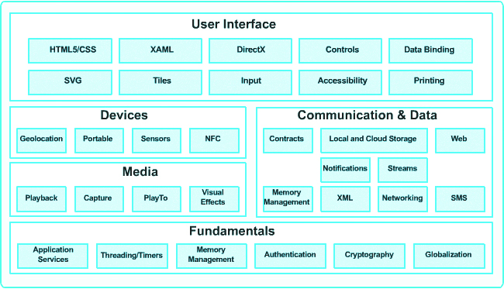
The WinRT APIs (Contd.)
  The WinRT APIs are shown in the following figure.
Notes:
6

Slide 7
The WinRT APIs (Contd.)
  Apps are created by using different programming and scripting languages.
  Apps created with different languages are able to communicate with WinRT.
  Windows 8 platform provides projection layers for different languages to communicate with WinRT.
Notes:
7

Slide 8
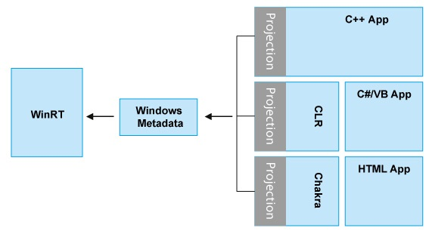
The WinRT APIs (Contd.)
  The language projection layer with respect to WinRT is shown in the following figure.
Notes:
8

Slide 9
The WinJS Library
Windows Library for JavaScript (WinJS)
Includes various WinJS controls for designing Windows Store apps.
Contains various API functions that can be used to implement common app requirements.
Allows providing a consistent appearance to apps by using predefined Cascading Style Sheet (CSS).
Notes:
9

Slide 10
The WinJS Library (Contd.)
  Each page that needs to use WinJS must contain references to the ui-dark.css/ ui-light.css, base.js, and ui.js files.
  WinJS provides the following features to develop apps easily that follow the Windows Store app guidelines:
Helper functions
Promise objects
Application events
WinJS.Navigation namespace
Page control
Data binding
Built-in animations for controls
WinJS.Utilities namespace
Default style sheets
Notes:
10

Slide 11
Asynchronous Programming
Asynchronous Programming
Ensures that the app stays active and responds to the user actions while the app waits for the current operation to complete.
Notes:
11

Slide 12
Task: Creating a New Windows Store Project
Let us create a new Windows Store project
Notes:
12

Slide 13


Structure of a Windows Store Project
Windows Store Project
References
css
Files
default.html
Directories
images
js
<Project_Name>_TemporaryKey.pfx
package.appxmanifest
Notes:
13

Slide 14
Task: Opening an Existing Windows Store Project
Let us open an existing Windows Store project
Notes:
14

Slide 15
Summary
  In this session, you learned that:
  Microsoft has introduced the Windows 8 operating system, which can be installed on various devices, such as computers, tablets, and smartphones.
  The WinRT APIs enable you to develop Windows Store apps easily and quickly.
  To develop Windows Store apps using HTML5 and JavaScript, you need the WinJS library.
  The WinJS library includes various WinJS controls for designing Windows Store apps.
  A Windows Store project is a container for an app’s source code, resource files, and configuration files. It contains several files and directories.
Notes:
15

Slide 16

Q&A

